Slide 1


lockbox

Slide 2

Why was lockbox created?

Slide 3
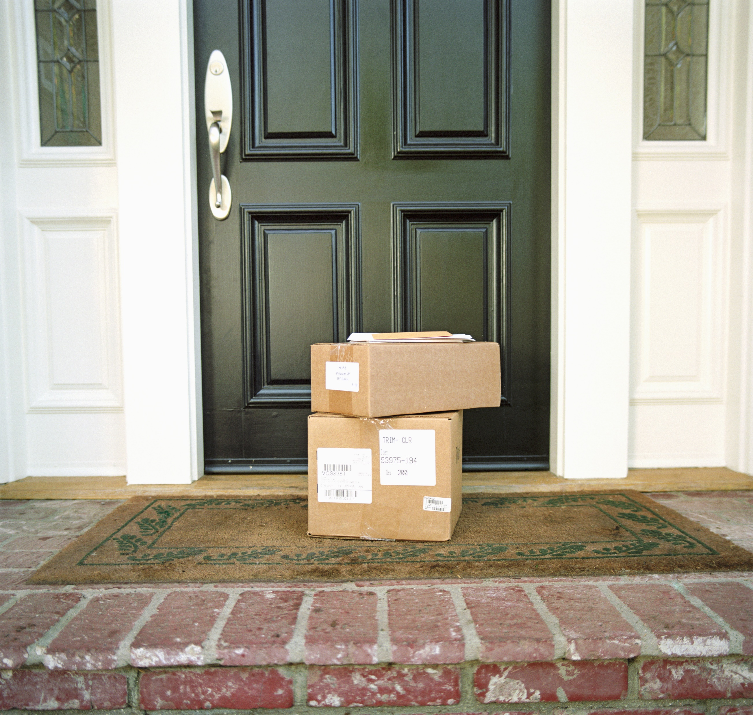
Problem

Slide 4
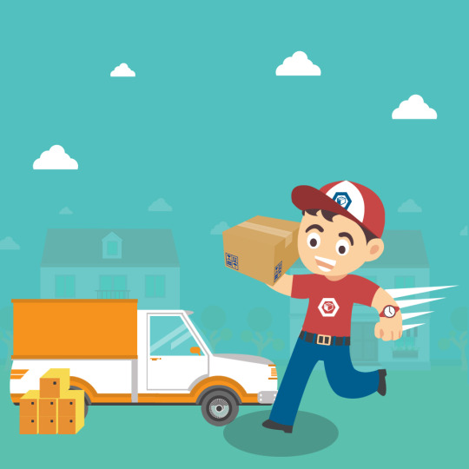
Late Shipments

Slide 5

Package Theft

Slide 6


Solution

Slide 7

Time Saving

Slide 8
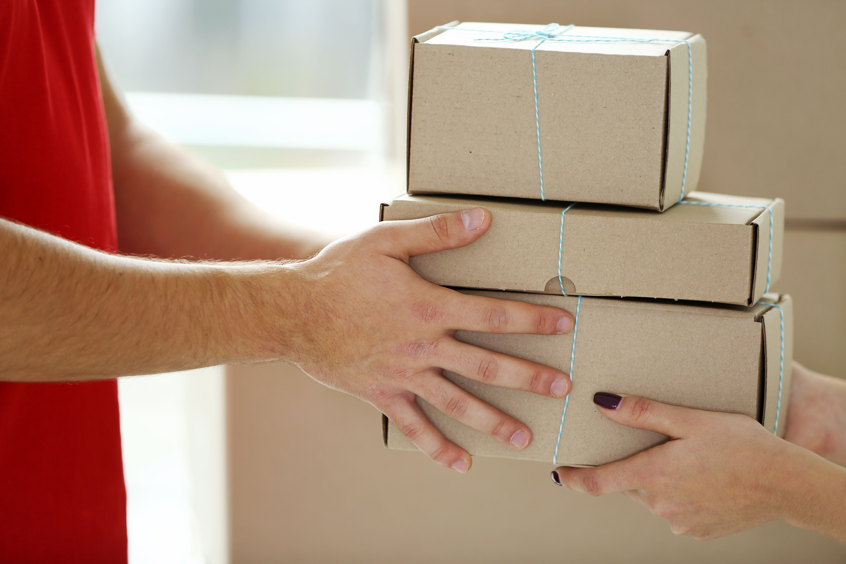
Safe & Reliable

Slide 9

Affordable

Slide 10

Competition

Slide 11

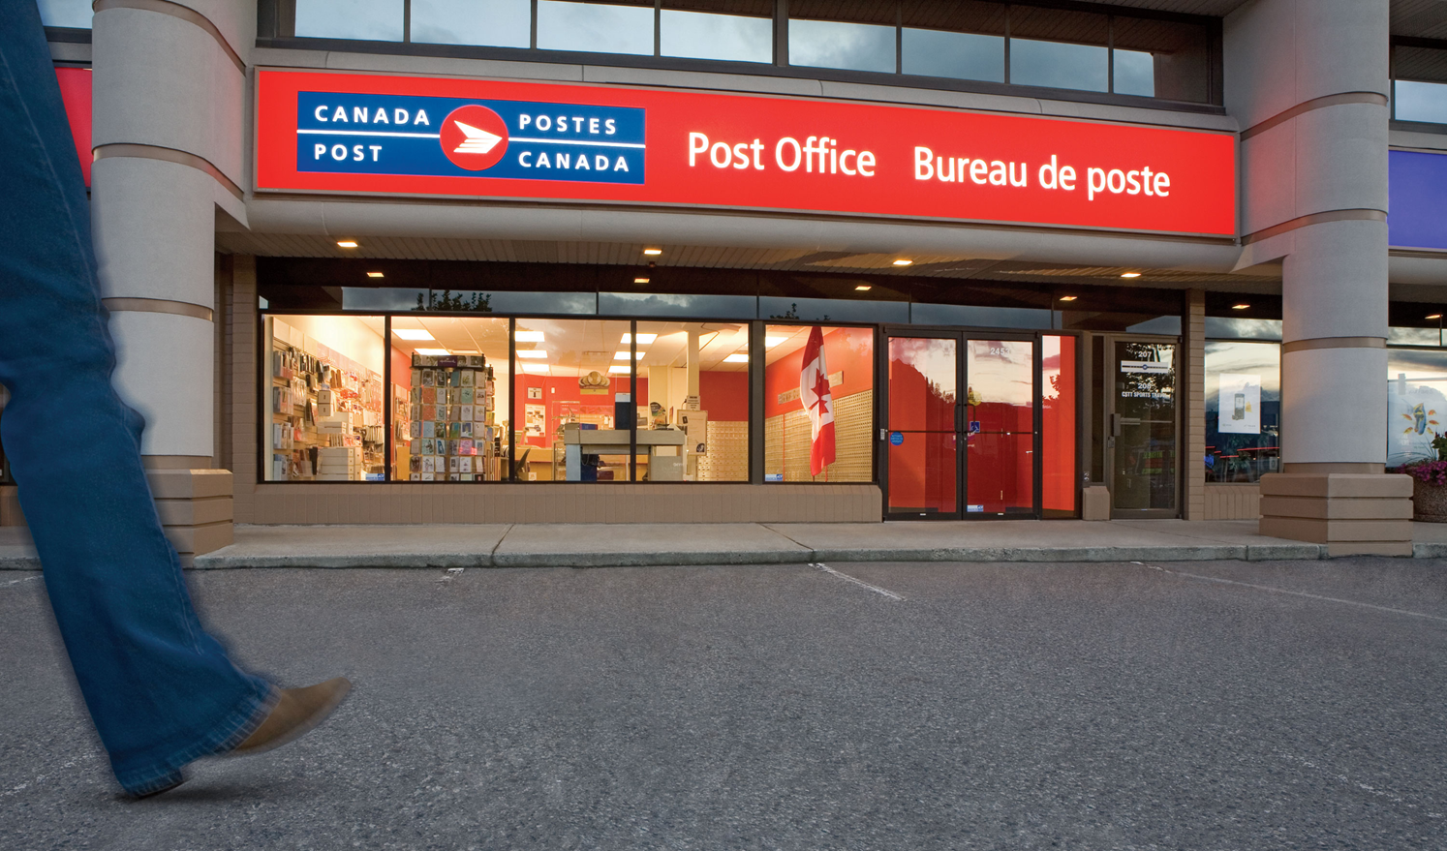

Slide 12

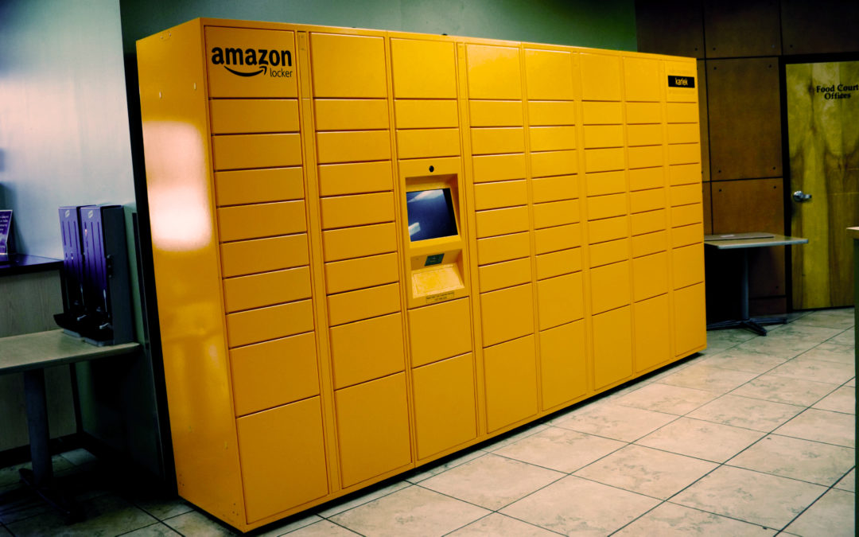

Slide 13

Why we are better

Slide 14

Market Analysis

Slide 15

Target
Market

Slide 16
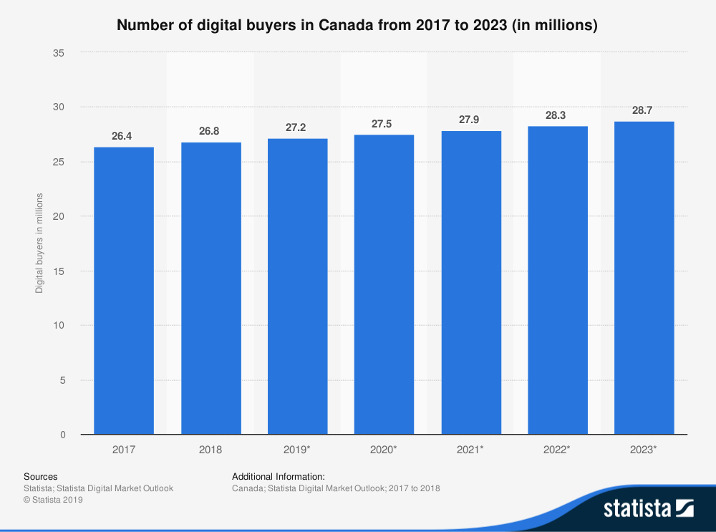
(See sources slide for sourcing)

Slide 17
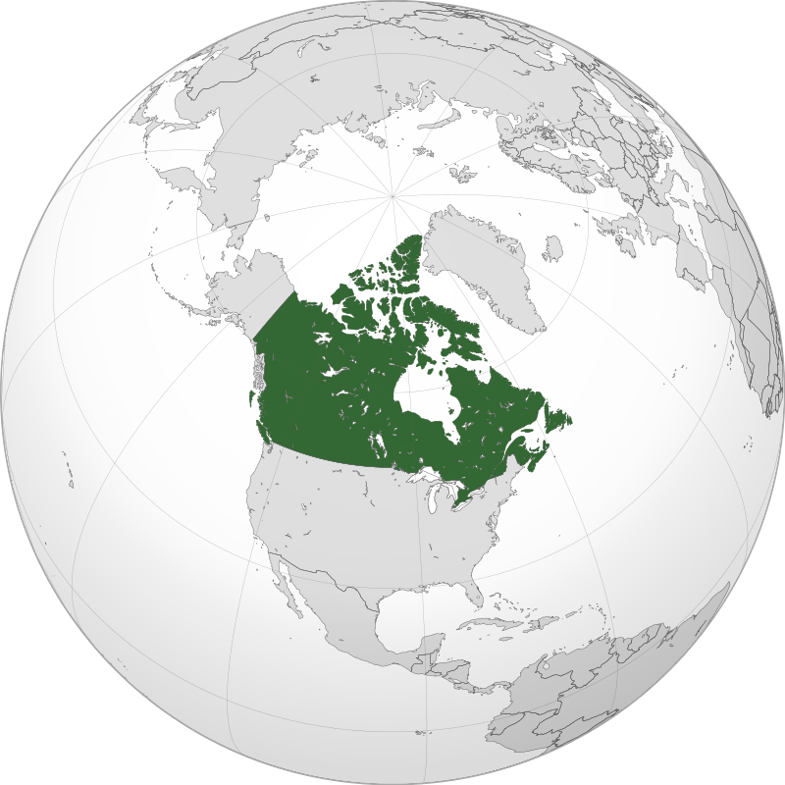
4.2 million
11%
(See sources slide for sourcing)

Slide 18
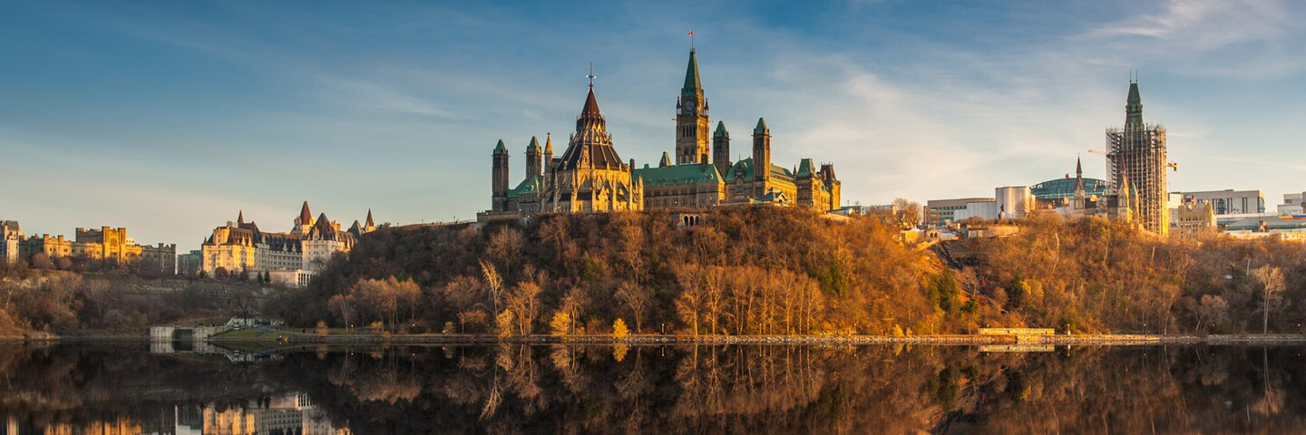
Population : ~1,000,000
~$550,000 to $650,000$ net revenue

Slide 19

Visit Our Website!
https://lockbox.web.app

Slide 20
Our Team
Our team

Slide 21
Contact us!
info@lockbox.ca
(613)-354-LOCK

Slide 22
Sources
https://www.statista.com/statistics/245143/number-of-online-buyers-in-canada/
https://www.statista.com/statistics/436978/online-purchases-made-category-canada/

